Slide 1
Stacked Models

Slide 2
The Stacking Idea
Given multiple ML models that are skillful on a problem, but in different ways, how do you choose?
Teamwork!
Base learners
Training data
Random forest
Training on predictions
made on test set
Bla
Bla
Gradient boosting
Bla
Bla
Super learner
a.k.a.
Meta-model
XGBoost
Predictions
Output
Bla
Bla
Linear regression
Bla
Better predictions than all individual models!
Notes:
Stacking is an ensemble learning technique that uses predictions from multiple models (for example decision tree, knn or svm) to build a new model. This model is used for making predictions on the test set that will be our training set for meta-model.
The meta-model is trained on the predictions made by base models. The outputs from the base models used as input to the meta-model. Predictions are features.
Ensemble learning improves a model’s performance mainly in three ways:
By reducing the variance of weak learners
By reducing the bias of weak learners,
By improving the overall accuracy of strong learners.

Slide 3
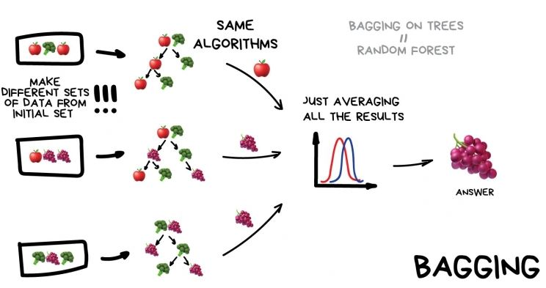
Ensemble Approach Bagging
Source
Notes:
There are 3 most common ensemble learning methods in machine learning.

Slide 4
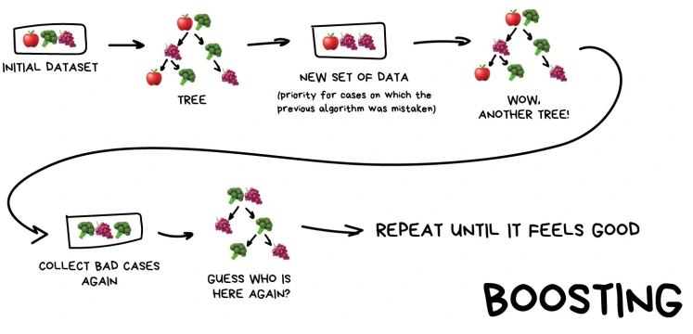
Ensemble Approach Boosting
Source

Slide 5
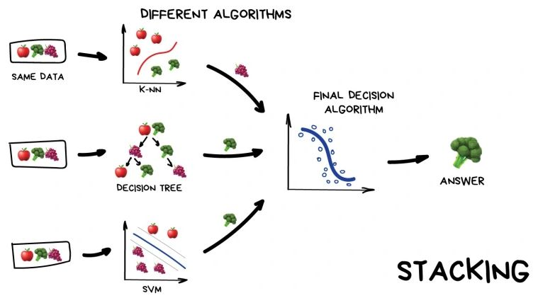
Ensemble Approach Stacking
Source
Notes:
In stacking, an algorithm takes the outputs of sub-models as input and attempts to learn how to best combine the input predictions to make a better output prediction.
Stacking trains multiple models using different algorithms independently. The predictions from the individual models are used as the features/predictors of a meta-model. The prediction from the meta-model is used as the final prediction.
Stacking is designed to ensemble a diverse group of strong learners.

Slide 6
Super learner algorithm
1
Set up the ensemble
Base learners
2
Train the ensemble
Train the base learners
Use k-fold cross-validation
3
Predict on new data
Train the meta-learner with predictions of base learners
Notes:
All models must be trained on the same training set.
All models must be trained with the same number of CV folds.
All models must use the same fold assignment to ensure the same observations are used (we can do this by using fold_assignment = "Modulo").
The cross-validated predictions from all the models must be preserved. Setting keep_cross_validation_predictions = TRUE. This is the data which is used to train the meta learner algorithm in the ensemble.

Slide 7
How stacking uses meta-model?
200 observations
80% training (160 obs.)
20% test (40 obs.)
k-fold
75% training
(120 obs.)
25% test
(40 obs.)
Final model accuracy is tested here
Base learners are
trained on this data
Predictions on test set becomes
training set for meta-model

Slide 8
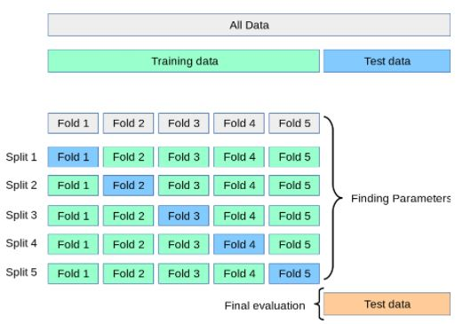
k-fold cross validation

Slide 9
Train the ensemble Super learner algorithm
Preparing training dataset for meta-model
# K-fold cross-validation
# train a model on 4/5 of the data and test on the remaining 1/5 of the data
# train on another 4/5 of the data and test on a different 1/5
# Multiple rows from the same UserId will be in the same set
k = 5
n = floor(nrow(data)/k) # size of each partition
error.vector = rep(NA,k) # store each error
folds <- groupKFold(data$UserId, k = k)
for(i in 1:k){
# Select a different fold (kth) each repetition to train
indexes <- folds[[k]]
train <- selected_features[indexes,]
test <- selected_features[-indexes,]
# Attach test set at the end of train set for training
rearrange.data <- rbind(train, test)
.
.
.
}
No data
leakage!
k-fold cross-validation

Slide 10
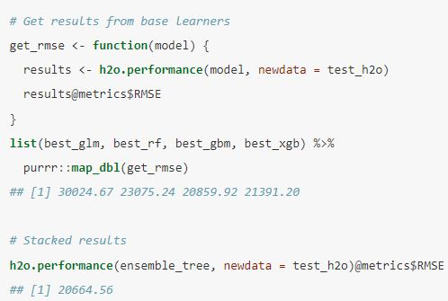
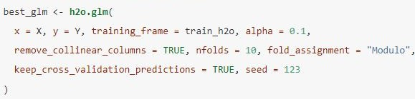

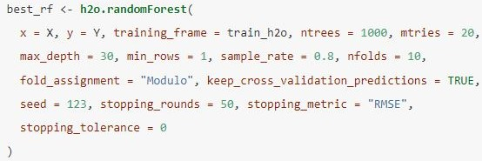
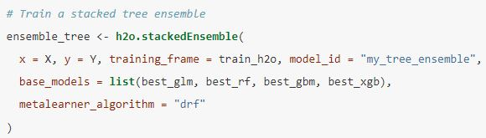
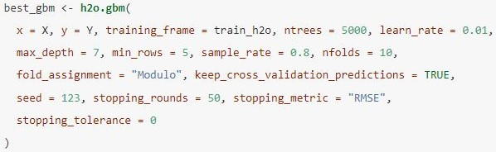
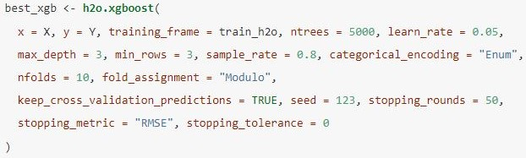
Implementation of stacking by using Ames housing dataset
4 base models are trained individually
Predictions of base models are used for training a final meta-model
Model Evaluation
GLM
Random forest
GBM
Is 0.9% (approx. 200 Euro) improvement worth for this complexity?
XGBoost
Recommended R package
library(h2o)

Slide 11

Thank you

